Slide 1

Collection Performance Analysis

Slide 2
Overview
A collection performance analysis for a student loan company aims to assess the effectiveness of the company's collection strategies and processes.
The analysis aims to identify areas where the company can improve its collections processes, reduce its default rates, and increase its recovery of outstanding debts.
Analysis pipeline;
Data Cleaning
Data Joining
Data Presentation
Conclusion
Recommendation
Key Areas of Interests.

Slide 3
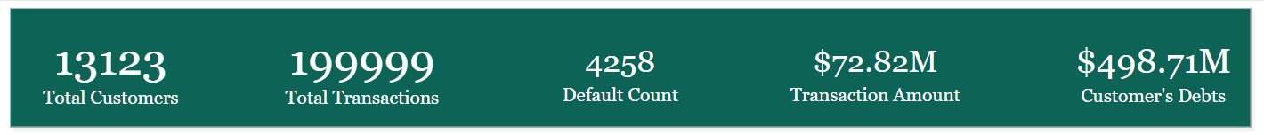
Key Performance Indicators (KPIs)

Slide 4
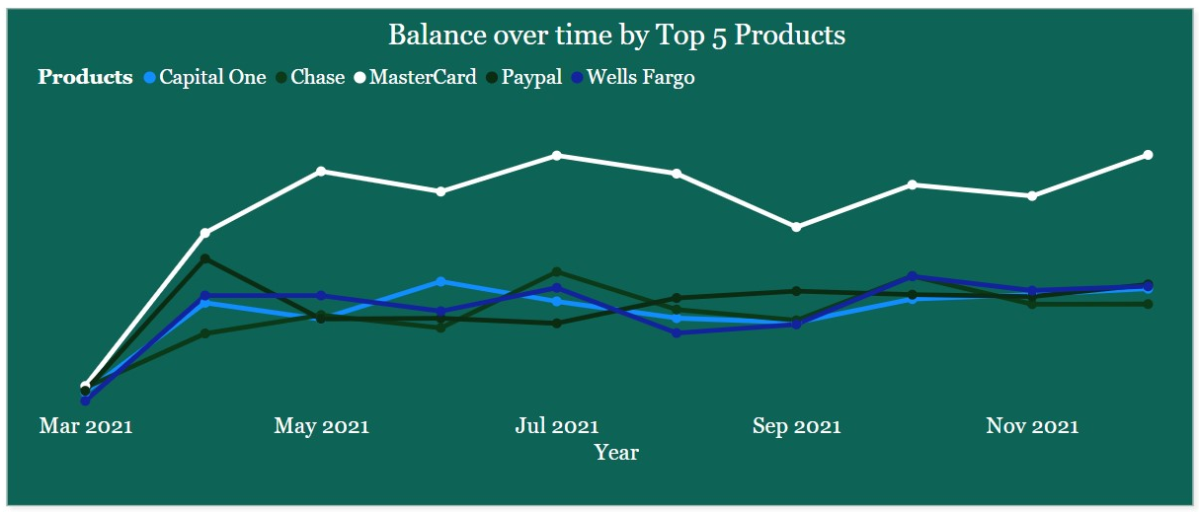
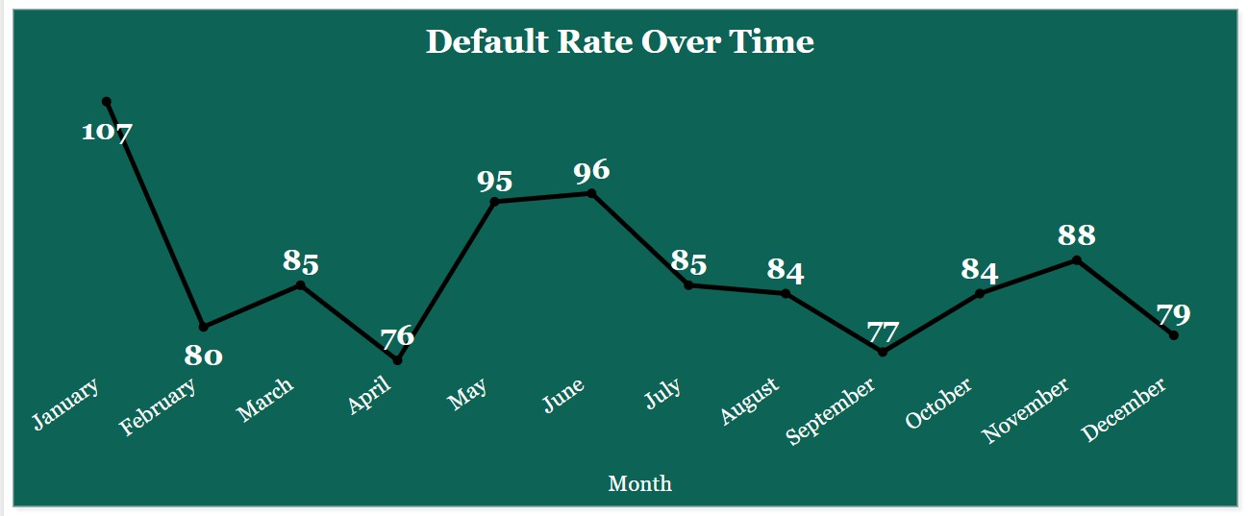
2021 Collection Performance Analysis
What’s the Trend in Outstanding Debts Over time By Top 5 Products in 2021?
What’s the trend in Default Rate Over Time in 2021?

Slide 5
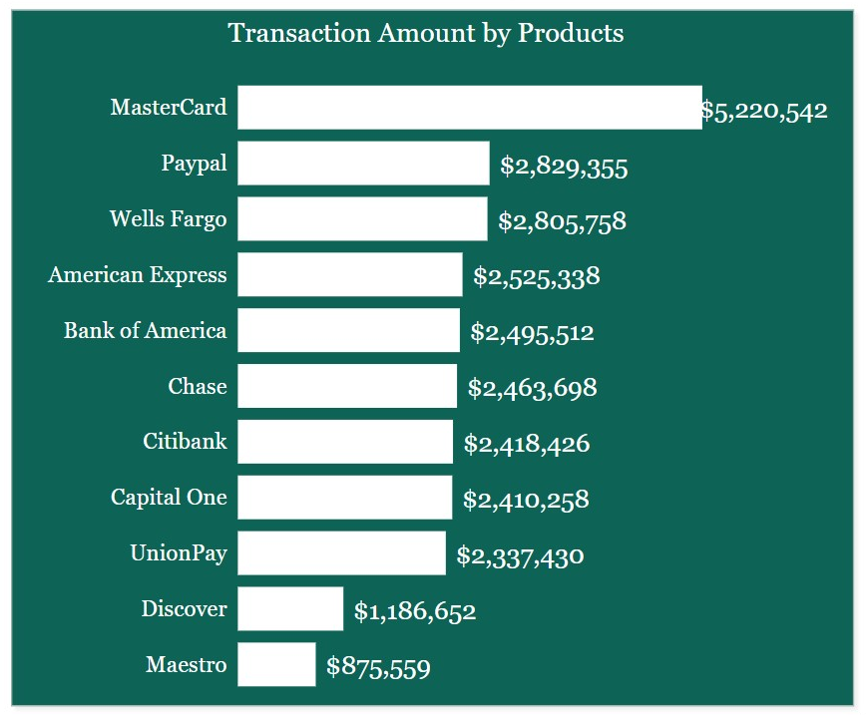
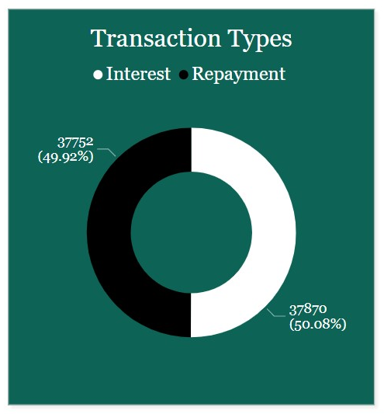
2021 Collection Performance Analysis
How much did each Product transact in 2021?
What’s the transaction types ratio in 2021?

Slide 6
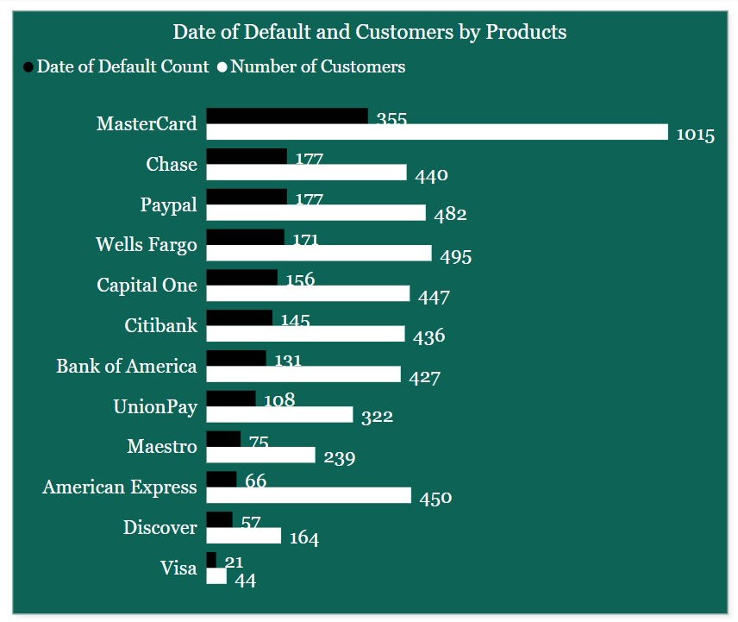
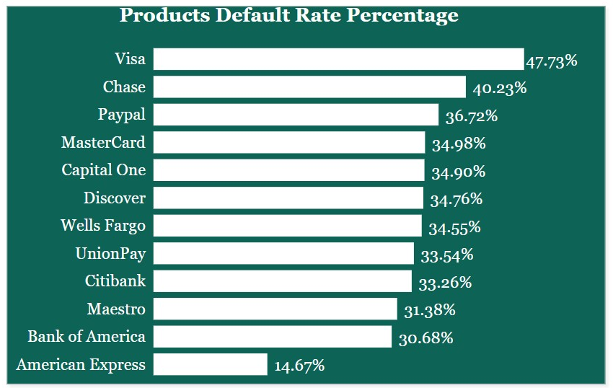
2021 Collection Performance Analysis
What is the Default Count and Customer count for each product in 2021?
What is the product’s Default Rate Percentage in 2021?

Slide 7
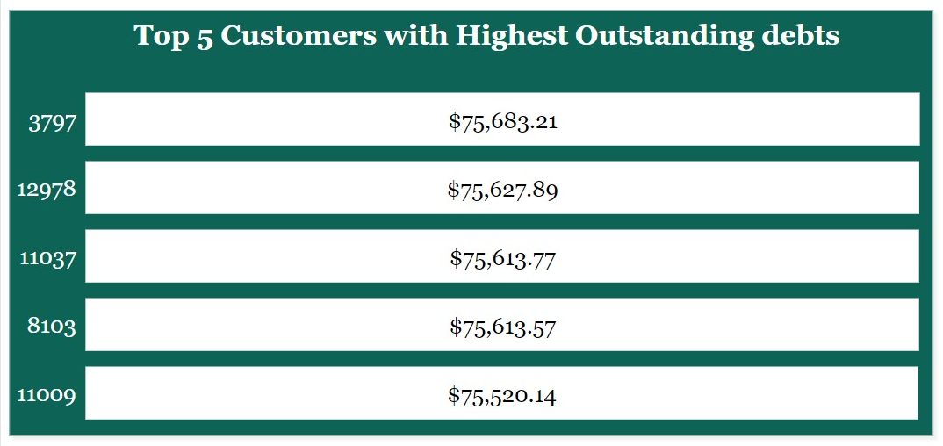
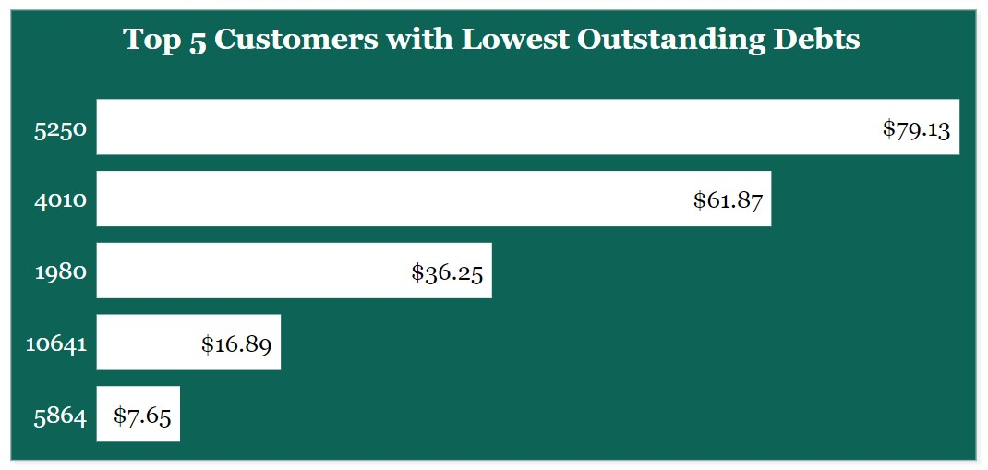
2021 Collection Performance Analysis
Who are the Top 5 Customers with the Highest Outstanding debts in 2021?
Who are the Top 5 Customers with the lowest Outstanding debts in 2021?

Slide 8
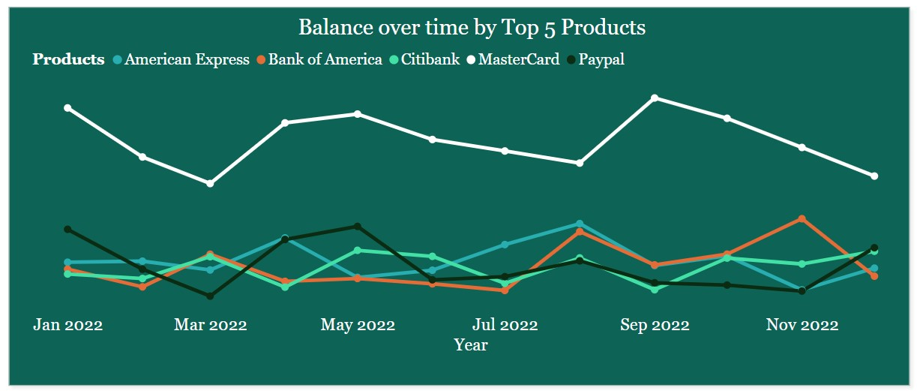
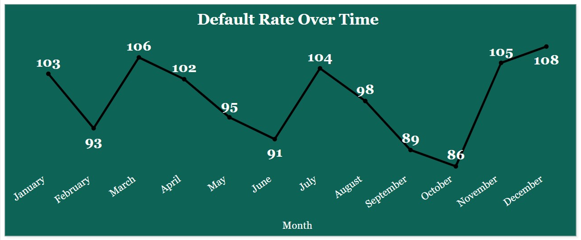
2022 Collection Performance Analysis
What’s the Trend in Outstanding Debts Over time By Top 5 Products in 2022?
What’s the trend in Default Rate Over Time in 2022?

Slide 9
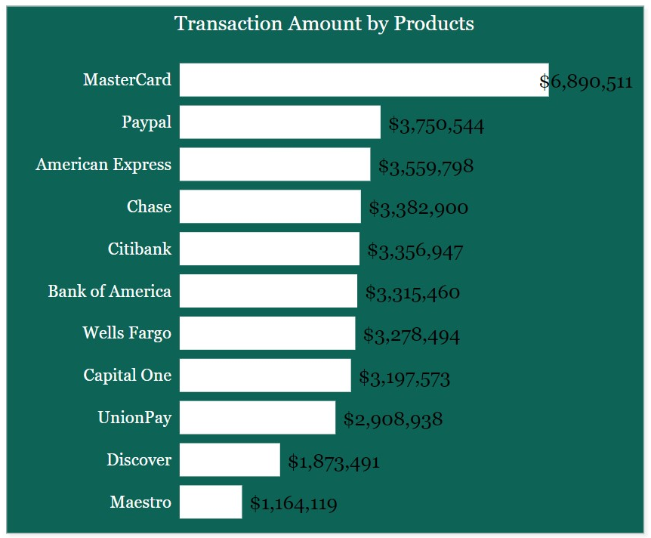
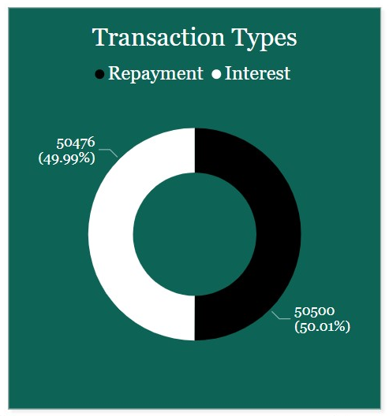
2022 Collection Performance Analysis
How much did each Product transact in 2022?
What’s the transaction types ratio in 2022?

Slide 10
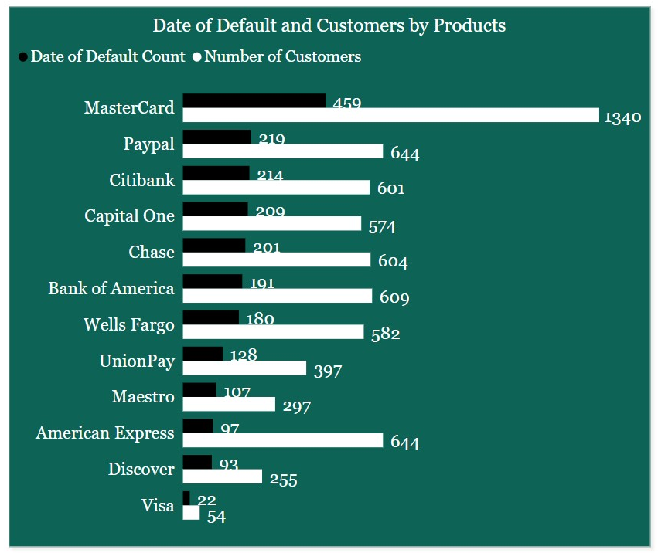
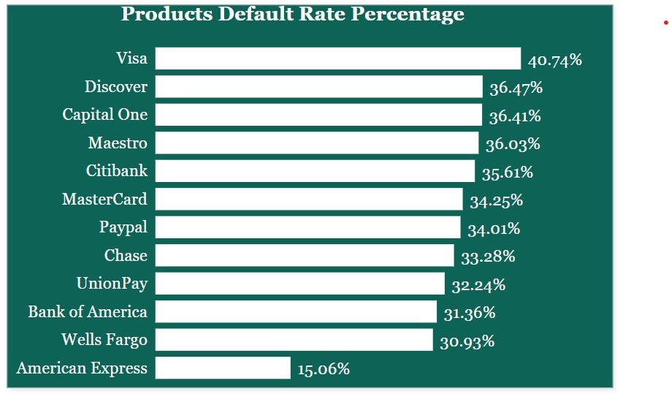
2022 Collection Performance Analysis
What is the Default Count and Customer count for each product in 2022?
What is the product’s Default Rate Percentage in 2022?

Slide 11
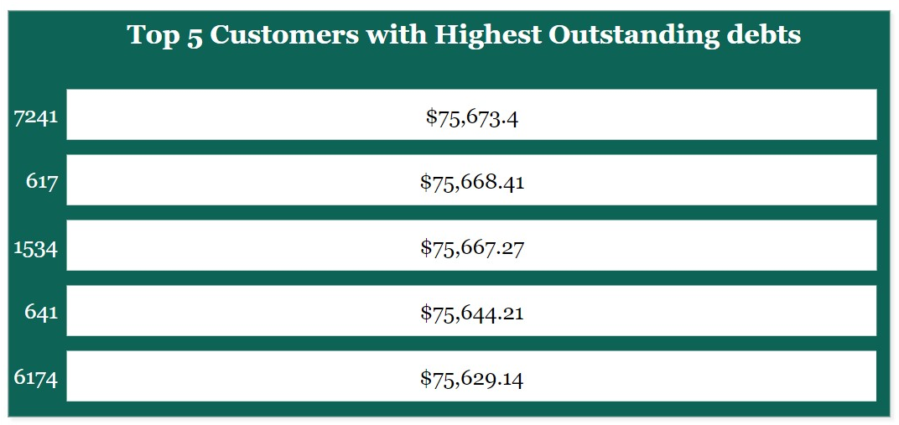
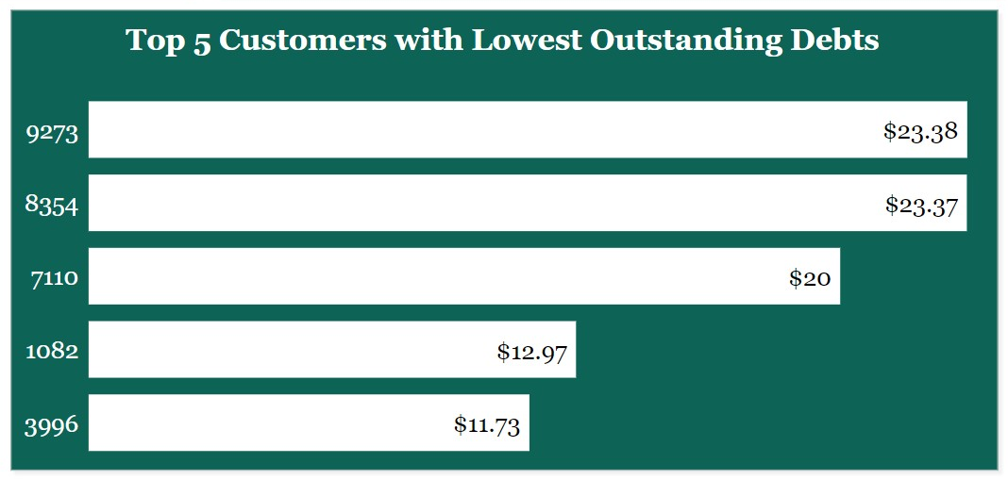
2022 Collection Performance Analysis
Who are the Top 5 Customers with the Highest Outstanding debts in 2022?
Who are the Top 5 Customers with the lowest Outstanding debts in 2022?

Slide 12
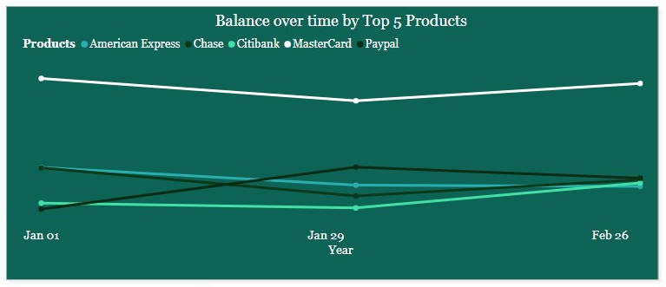
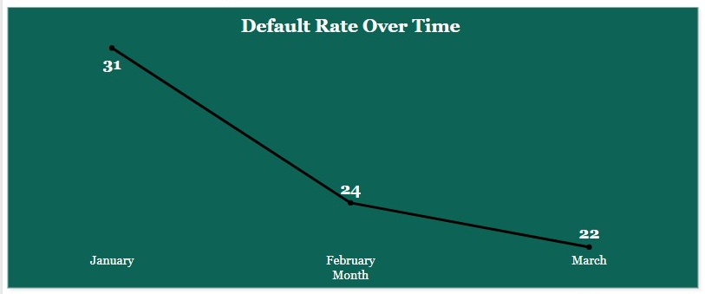
2023 Collection Performance Analysis
What’s the Trend in Outstanding Debts Over time By Top 5 Products in 2023 (Jan - March)?
What’s the Default Rate Over Time trend in 2023 (Jan - March)?

Slide 13
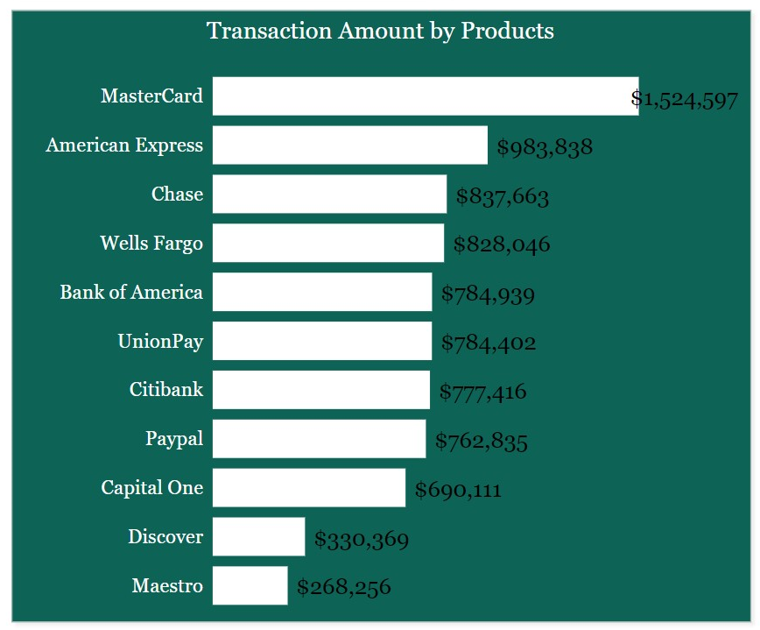
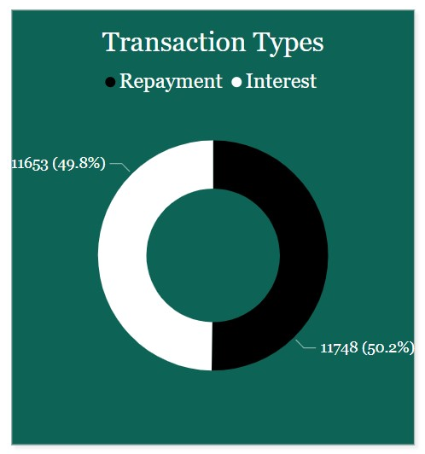
2023 Collection Performance Analysis
How much did each Product transact in 2023?
What’s the transaction types ratio in Jan – March 2023?

Slide 14
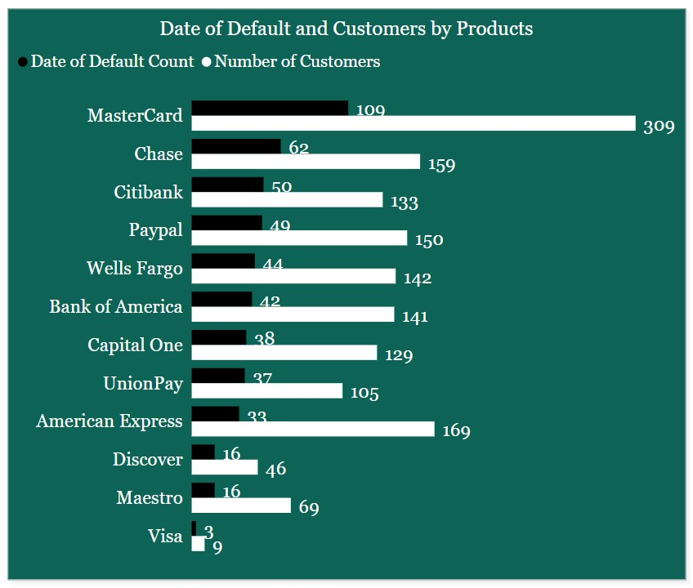
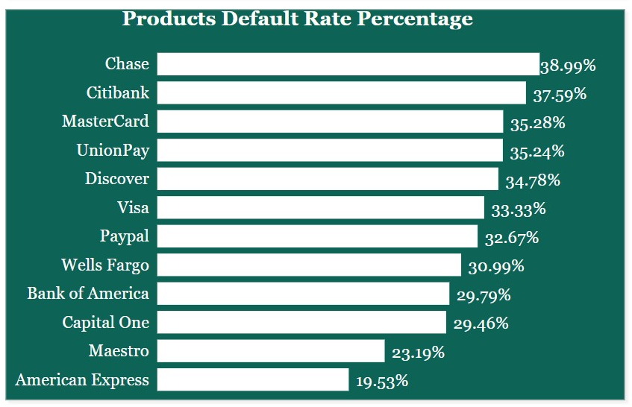
2023 Collection Performance Analysis
What is the Default Count and Customer count for each product in Jan – March 2023?
What is the product’s Default Rate Percentage in Jan – March 2023?

Slide 15
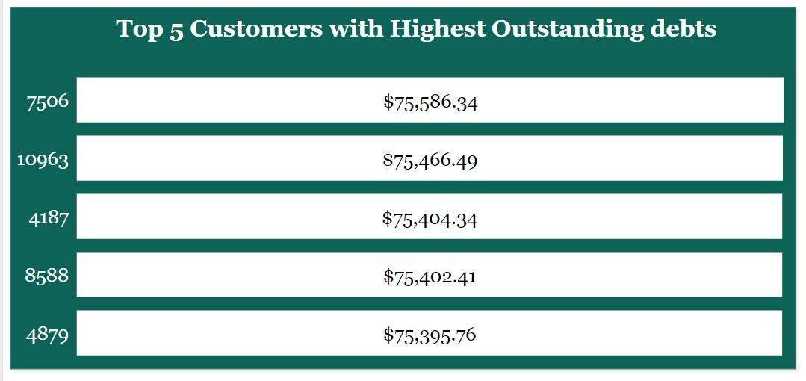
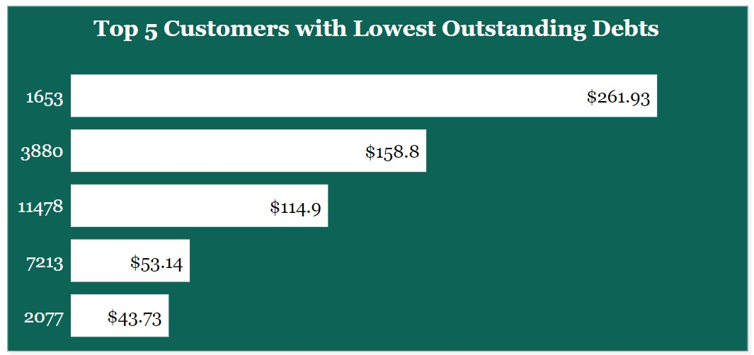
2023 Collection Performance Analysis
Who are the Top 5 Customers with the Highest Outstanding debts in Jan – March 2023?
Who are the Top 5 Customers with the lowest Outstanding debts in Jan – March 2023?

Slide 16
Key Areas of Interests
Default rates: The clustered column chart showing the number of customers that use each product with their Date of Default count is an important metric to track. If the default count increases over time, it may indicate that the collection strategy is ineffective, and further action may be necessary.
Product performance: The line chart showing the balance over time, broken down by top 5 product type is a useful tool to identify trends in balances by product. If there are any significant differences in performance between products, it may indicate a need to adjust collection strategies or marketing efforts.
Repayment vs Interest: The doughnut chart showing the percentage of transaction type (repayment or interest) is an important metric to track. If the proportion of interest payments increases over time, it may indicate that customers are struggling to make payments, and further action may be necessary.
Top customers: The bar charts showing the 5 top customers with the highest and lowest outstanding debts are useful for identifying customers who may need additional attention. It is important to ensure that high-risk customers receive the support they need to avoid defaulting on their loans.
Overall, these metrics can provide valuable insights into the performance of the collection strategy and identify areas that may require further attention or improvement

Slide 17
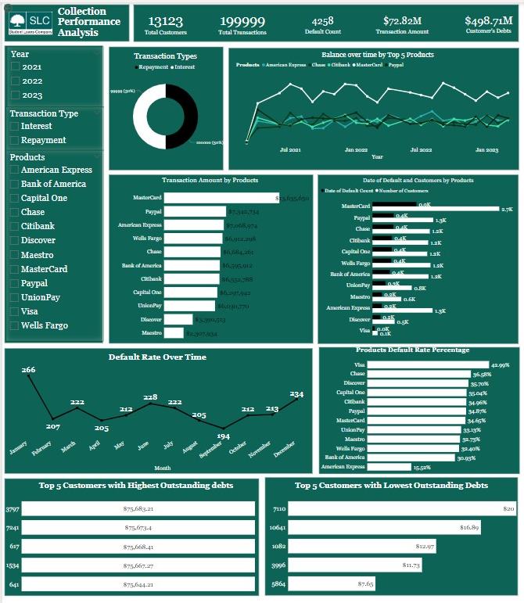
Conclusion
Collection Performance Dashboard
The collection strategy is at average. Most customers enter arrears after missing a repayment on their debt within the years.
The high concentration of customers using one specific product indicates an opportunity to expand the product portfolio and diversify the customer base.
Both Repayments and interest transactions take up 50% each of all the total transactions done for the years.
The variation in transaction amounts and default rate percentage by product type requires further investigation to determine the underlying reasons for the differences.

Slide 18
Recommendation
Further analysis should be conducted to understand the drivers of variation in transaction amounts and default rate percentage by product type.
The product type with the highest defaults requires closer monitoring and intervention.
The concentration of defaults around the end of the year suggests that seasonal factors may contribute to financial difficulties for customers, which should be considered in collection strategies.
The transaction amounts for each product type can inform marketing and promotional strategies to encourage more spending on loans with lower transaction amounts.
Optimizing the Collection scoring model system by incorporating additional variables such as customer demographics & payment history
Revamping the company collections outreach strategy for a major credit card issuer.
Optimizing the current collection strategy will give way to an effective strategy for reducing the outstanding debt owed by customers.
Encourage customers to make repayments on time to reduce the number of customers entering arrears after missing a repayment on their debt.

